Slide 1
Chapter 11
Frequency Response Analysis

Slide 2
Overall Course Objectives
Develop the skills necessary to function as an industrial process control engineer.
  Skills
    Tuning loops
    Control loop design
    Control loop troubleshooting
    Command of the terminology
  Fundamental understanding
    Process dynamics
    Feedback control

Slide 3
Frequency Response Analysis
Is the response of a process to a sinusoidal input
Considers the effect of the time scale of the input.
Important for understanding the propagation of variability through a process.
Important for terminology of the process control field.
But it is NOT normally used for tuning or design of industrial controllers.

Slide 4
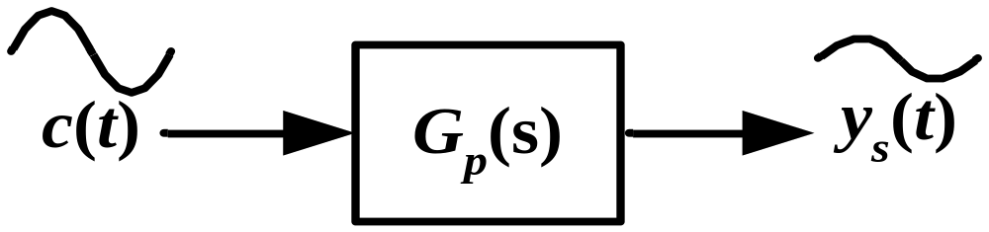
Process Exposed to a Sinusoidal Input

Slide 5
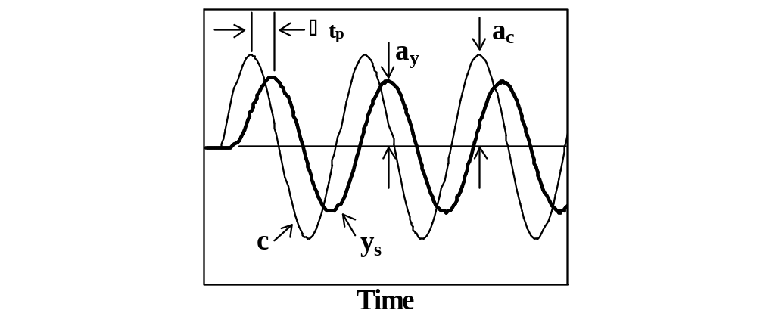
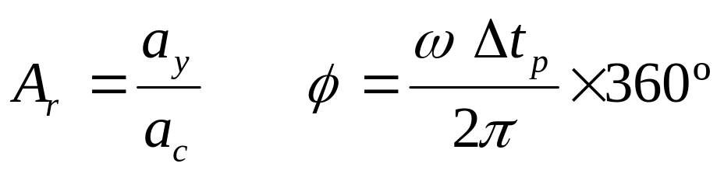
Key Components of Frequency Response Analysis

Slide 6
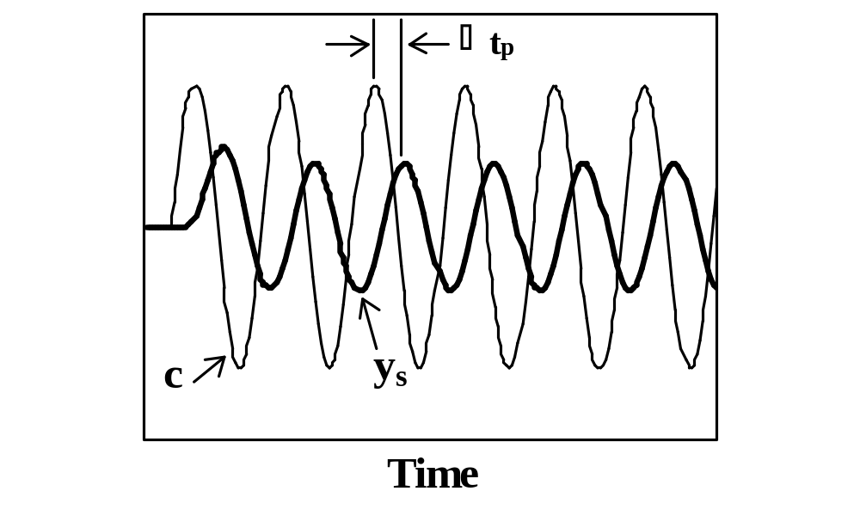
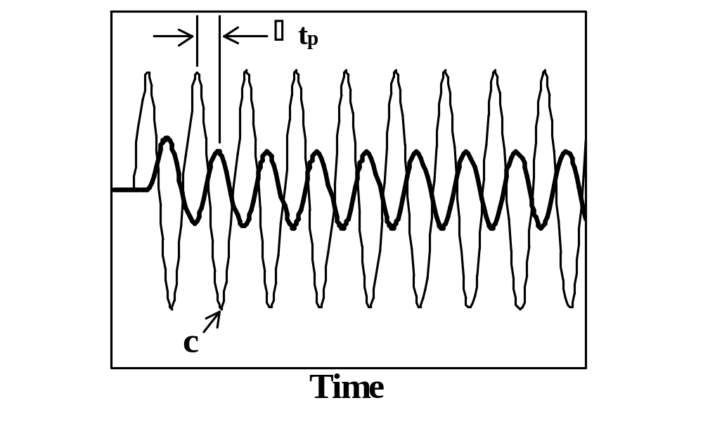
Effect of Frequency on A_{r} and φ

Slide 7
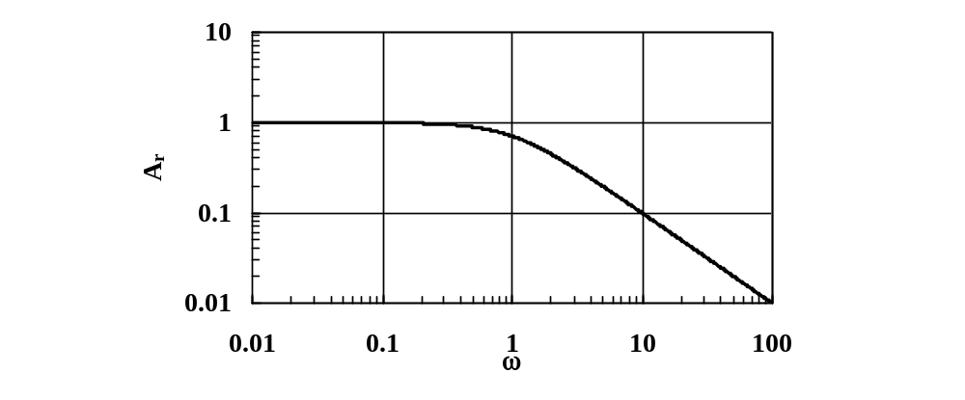
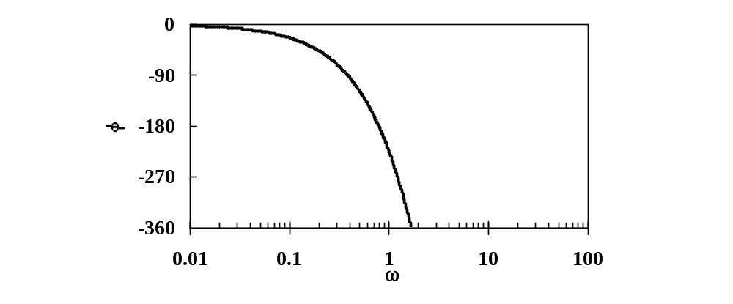
Bode Plot: A Convenient Means of Presenting A_{r} and φ versus ω

Slide 8
Ways to Generate Bode Plot
Direct excitation of process.
Combine transfer function of the process with sinusoidal input.
Substitute s=i ω into G_{p}(s) and convert into real and imaginary components which yield A_{r}(ω) and φ(ω).
Apply a pulse test.

Slide 9
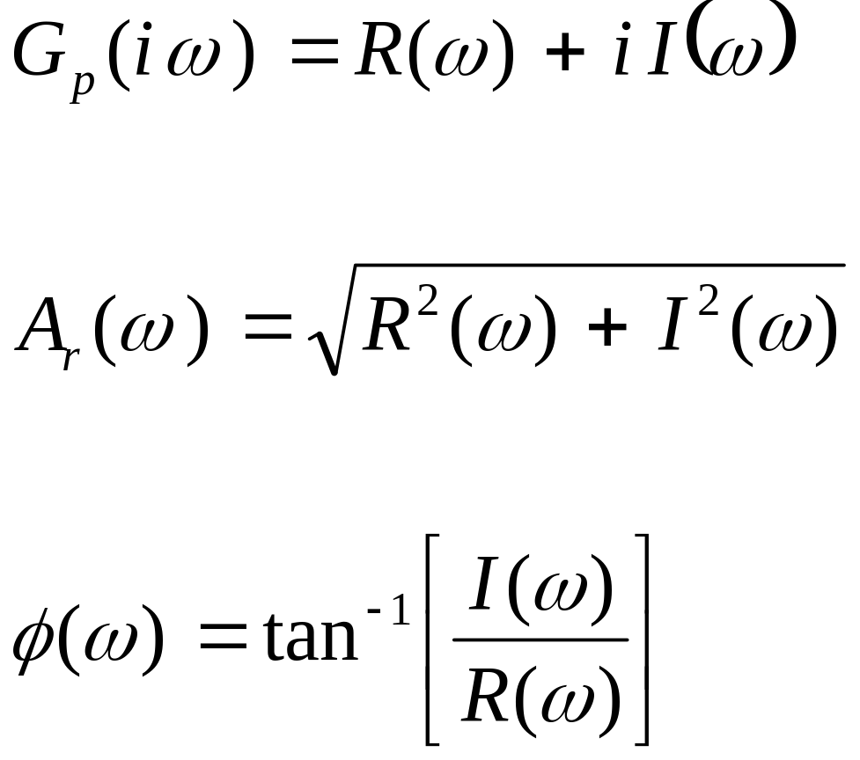
Developing a Bode Plot from the Transfer Function

Slide 10
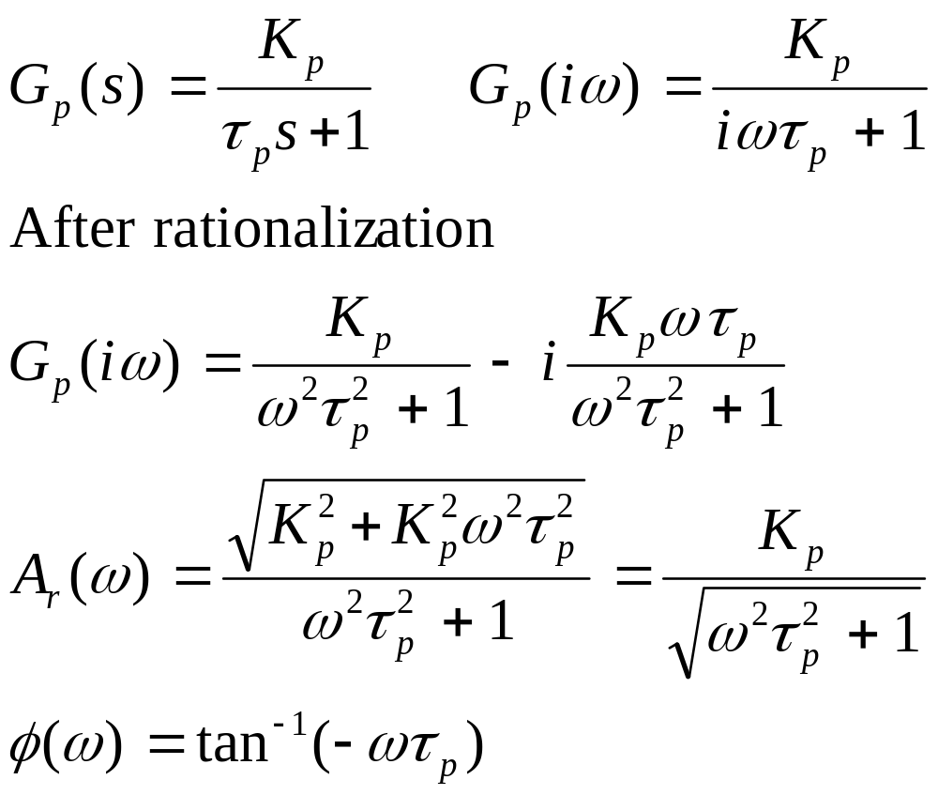
Derivation of the Bode Plot for a First Order Process

Slide 11
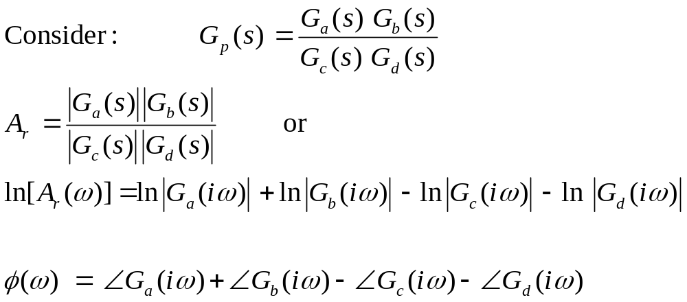
Properties of Bode Plots

Slide 12
Bode Plot of Complex Transfer Functions
Break transfer function into a product of simple transfer functions.
Identify A_{r}(ω) and φ(ω) of each simple transfer function from Table 8.1.
Combine to get A_{r}(ω) and φ(ω) for complex transfer function according to properties.
Plot results as a function of ω.

Slide 13
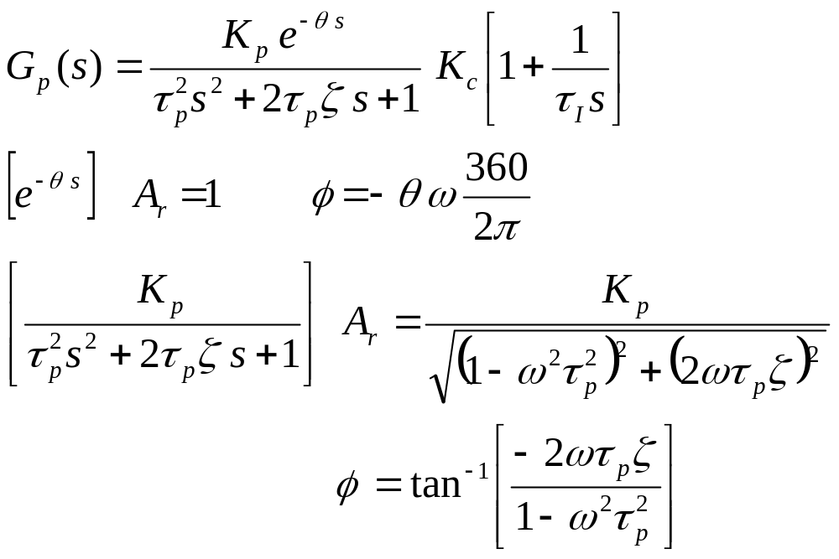
Example of a Bode Plot of a Complex Transfer Function

Slide 14
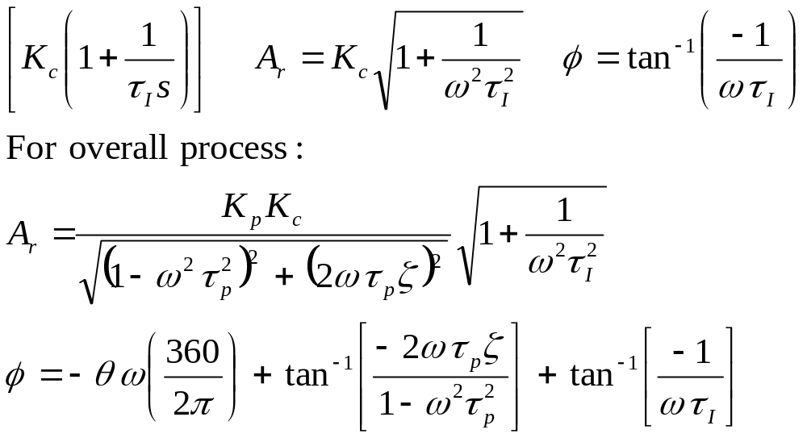
Example Continued

Slide 15
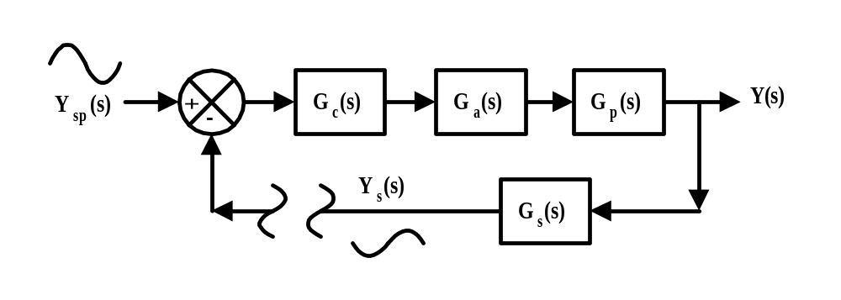
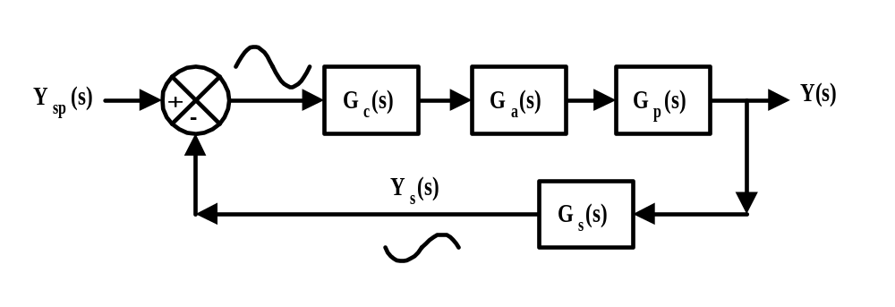
Bode Stability Criterion

Slide 16
Bode Stability Criterion
A system is stable if A_{r} is less than 1.0 at the critical frequency (i.e., ω that corresponds to φ=-180º)
Closed loop stability of a system can be analyzed by applying the Bode Stability Criterion to the product of the transfer functions of the controller and the process, i.e., G_{c}(s)G_{p}(s).

Slide 17
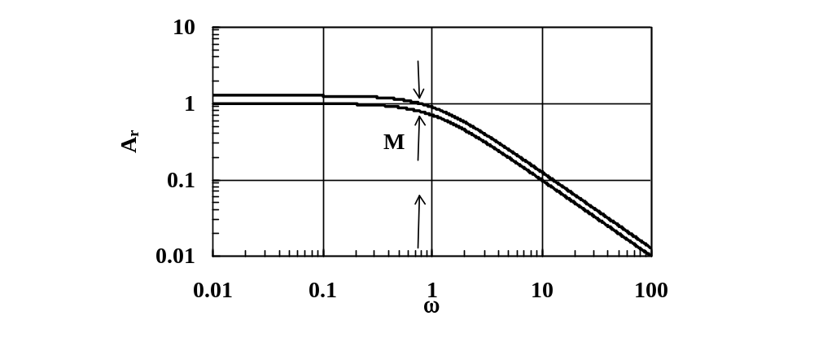
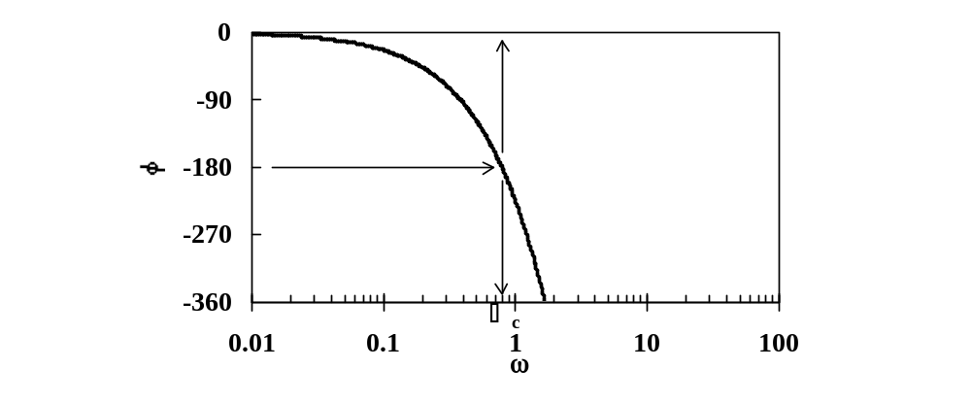
Gain Margin

Slide 18
Gain Margin
Gain Margin = 1/A_{r}*
  Where A_{r}* is the amplitude ratio at the critical frequency.
  Controllers are typically designed with gain margins in the range of 1.4 to 1.8 which implies that A_{r} at the critical frequency varies between 0.7 and 0.55, respectively.

Slide 19
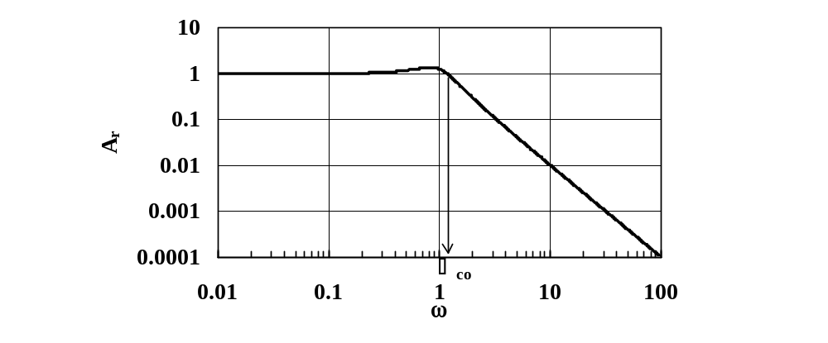
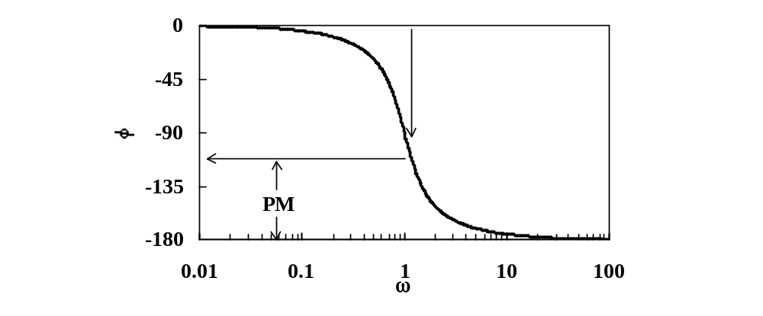
Phase Margin

Slide 20
Phase Margin
PM = φ∗ − (−180)
  Where φ* is φ at the crossover frequency.
  Controllers are typically designed with a PM between 30º to 45º.

Slide 21
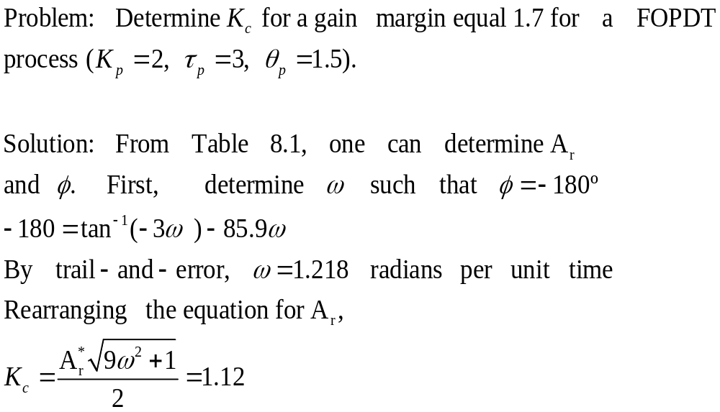
Tuning a Control from the Gain Margin

Slide 22
Tuning a Control from the Phase Margin
Phase margin determines the phase angle at the crossover frequency.
The amplitude ratio at the crossover frequency is one; therefore, the controller gain can be calculated from the equation for the amplitude ratio.

Slide 23
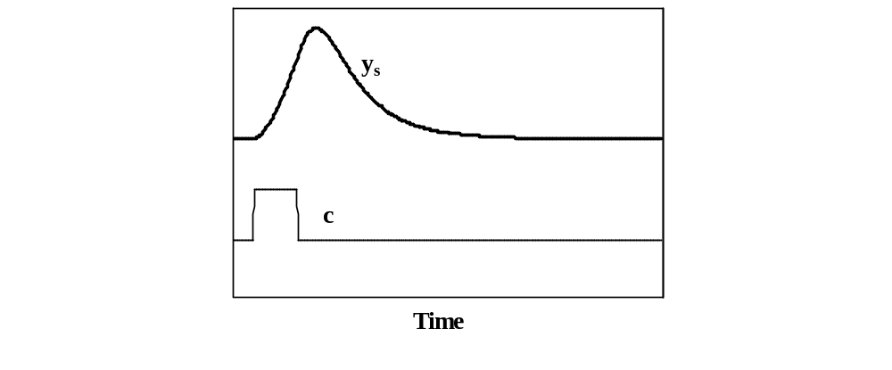
Example of a Pulse Test

Slide 24
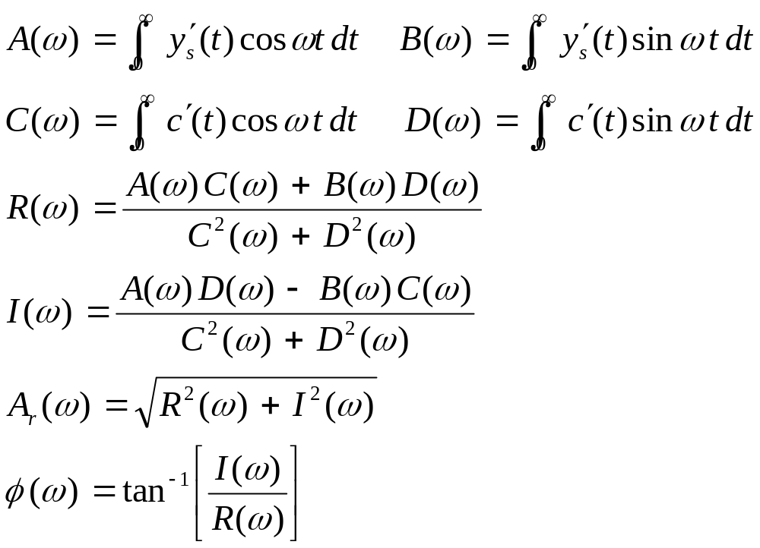
Developing a Process Transfer Function from a Pulse Test

Slide 25
Limitations of Transfer Functions Developed from Pulse Tests
They require an open loop time constant to complete.
Disturbances can corrupt the results.
Bode plots developed from pulse tests tend to be noisy near the crossover frequency which affects GM and PM calculations.

Slide 26
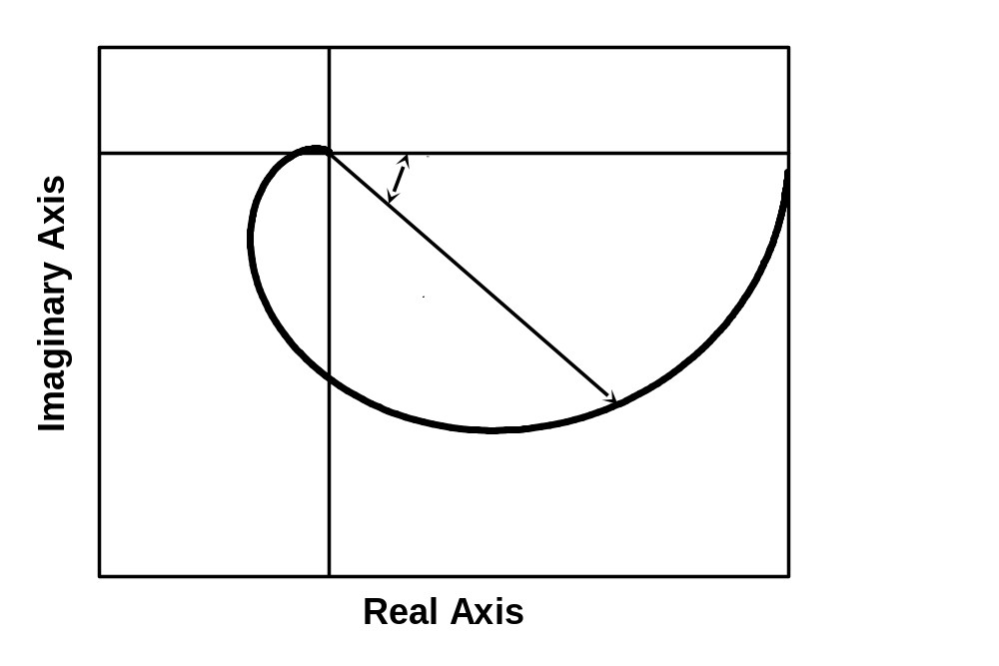
Nyquist Diagram

Slide 27
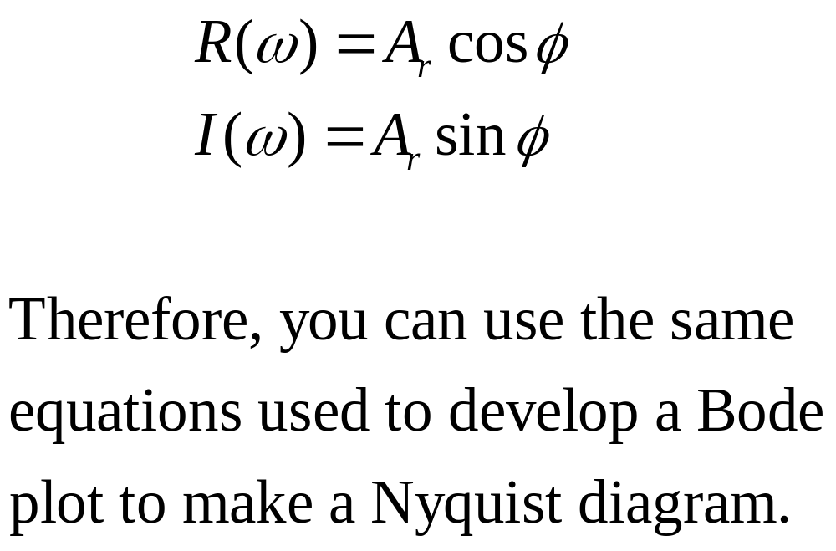
Nyquist Diagram
(Complex Plane Plot)

Slide 28
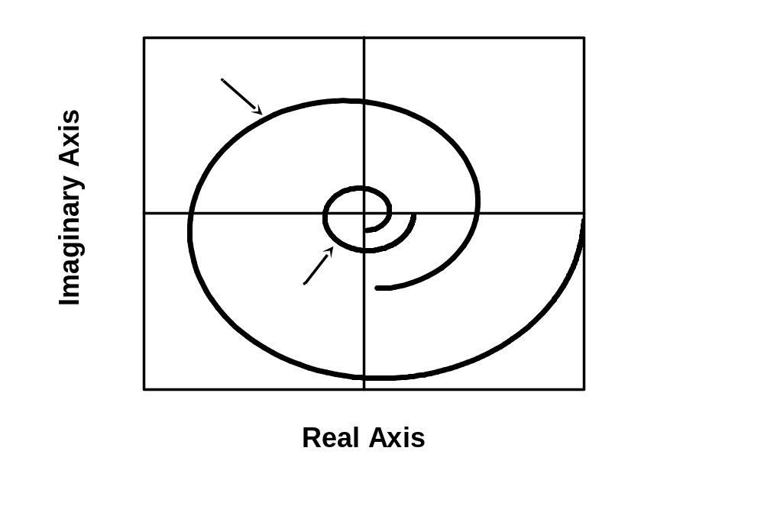
Nyquist Stabilty Criterion

Slide 29
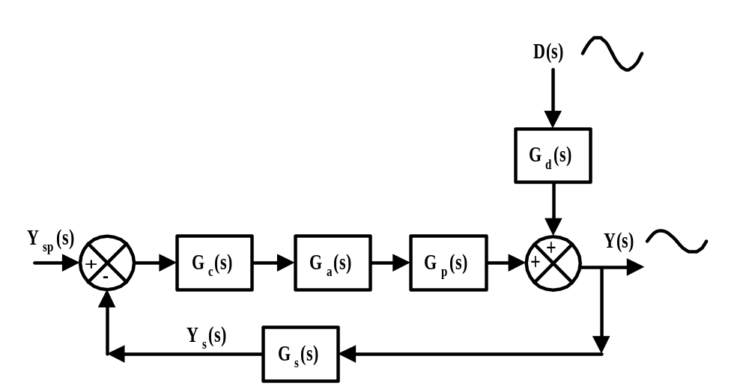
Closed Loop Frequency Response

Slide 30
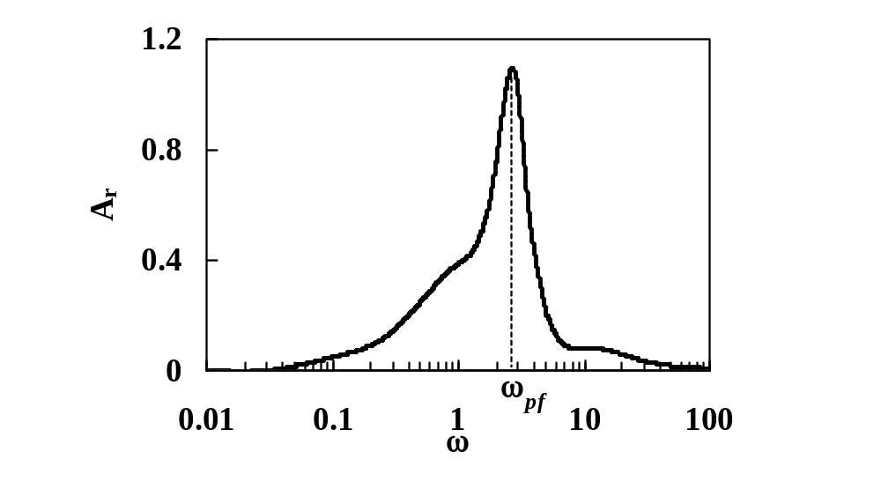
Example of a Closed Loop Bode Plot

Slide 31
Analysis of Closed Loop Bode Plot
At low frequencies, the controller has time to reject the disturbances, i.e., A_{r} is small.
At high frequencies, the process filters (averages) out the variations and A_{r} is small.
At intermediate frequencies, the controlled system is most sensitive to disturbances.

Slide 32
Peak Frequency of a Controller
The peak frequency indicates the frequency for which a controller is most sensitive.

Slide 33
Overview
Understanding how the frequency of inputs affects control performance and control loop stability is important.
The analytical aspects of frequency response analysis are rarely used industrially.

